Slide 1
IDC Grant Reimbursement & Progress Reporting Revised 3-3-2020

Slide 2
Quarterly Grant Reporting
To complete quarterly reporting requirements the following must be submitted in CCJJ’s Grant Management System (GMS) by the dates specified in Attachment E of the FY20 Grant Award Agreement:
IDC Grantee Quarterly Progress Report
IDC Reimbursement Worksheet and Ledger (Spreadsheet Provided by IDC)
These documents must be uploaded into the GMS to receive reimbursement
You must provide documentation showing your grant and system side spending as agreed upon in your grant award.
Supporting documentation validating your ledger must be retained in your grant files for monitoring reviews or audits. Quarterly submission is no longer required.
a. Supporting documentation includes:
Proof of Expenses (Vendor invoices, mileage forms, contracts, purchase orders, receipts, Etc.)
Proof of Payments ( Check stubs, EFT stubs, Receipts, Etc.)

Slide 3
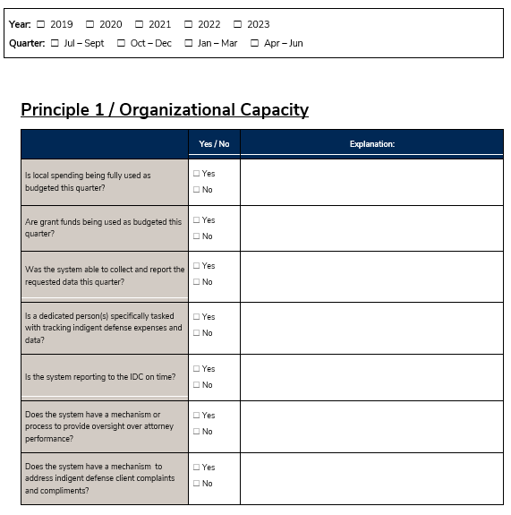
IDC Quarterly Grant Progress Report
The Quarterly GPR has been re-designed for FY20:
Purpose:
Gather baseline data tied to each IDC Core Principle
Assist systems to meet IDC Core Principles
Demonstrate compliance and return on investment to the Utah State Legislature
What that means to you:
Requires coordination with your indigent defense providers
Highly important to accurately report in order to support future funding requests
Review the reporting document now so you are tracking what you need to
We’re here to help!
Excerpt:

Slide 4
Expense Reporting and Verification
Reimbursement Worksheet: The spreadsheet contains detailed instructions and must be completed by the grantee (city, county, interlocal) level, not a contractor. If you have not received a reimbursement worksheet with your grant budget populated, please contact the IDC grant program manager. Once you have entered your expenses the reimbursement spreadsheet will calculate the grant reimbursable portion of each line item based on the grant award contract and payment structure.
Ledger Tab: A ledger is included as a tab within the reimbursement worksheet. All expenses for indigent defense services for the period should be listed on the ledger individually. This includes both local spending and IDC requested reimbursement expenses. The sum of the entries on the ledger must reflect the total spending for local indigent defense services for the period, and should match what you enter on the Reimbursement Worksheet.
Budget Detail Report: This may be submitted in lieu of completing the ledger tab as long as it shows all system spending for the quarter and aligns with the expenses reported on the Reimbursement Worksheet. The grantee should notate the report as needed so IDC staff can reconcile it with the report with the Reimbursement Worksheet.

Slide 5
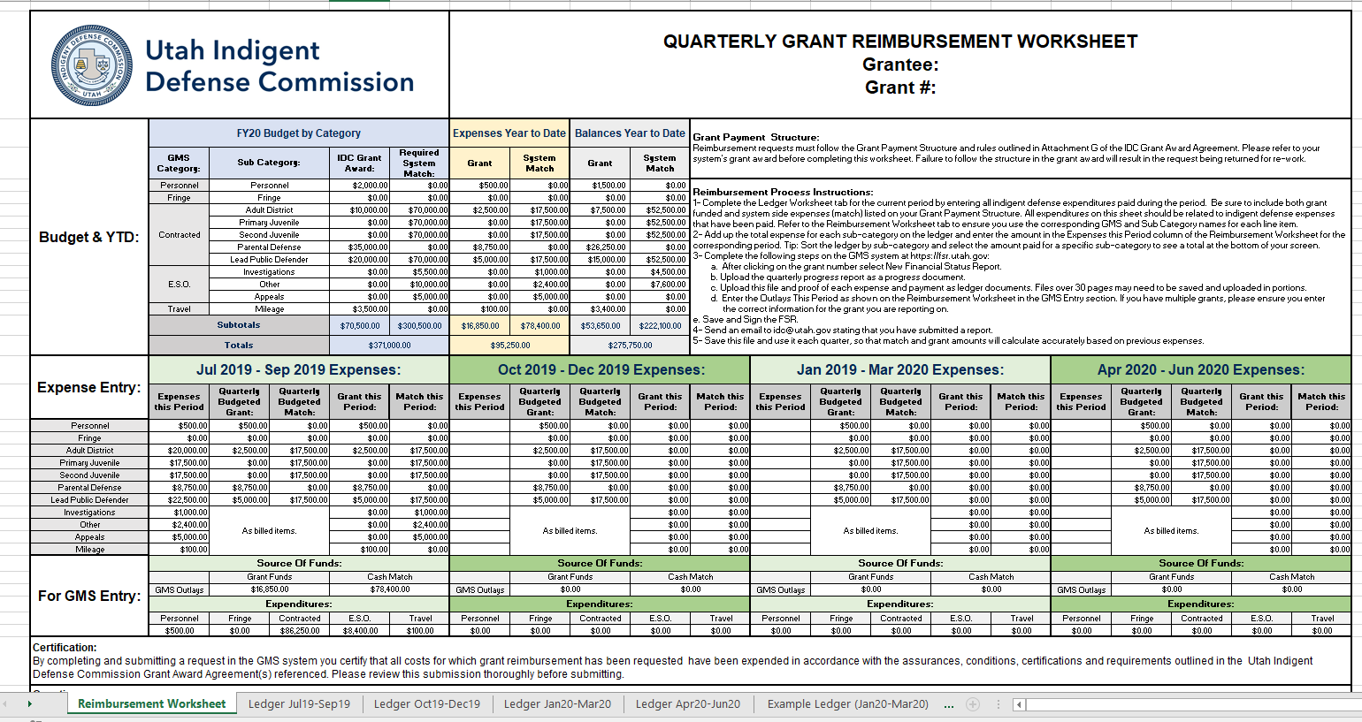
IDC Reimbursement Worksheet
This budget should match your grant award.
Step by step instructions are provided here.
Complete the ledger tab first. Make sure to select the correct reporting period.

Slide 6
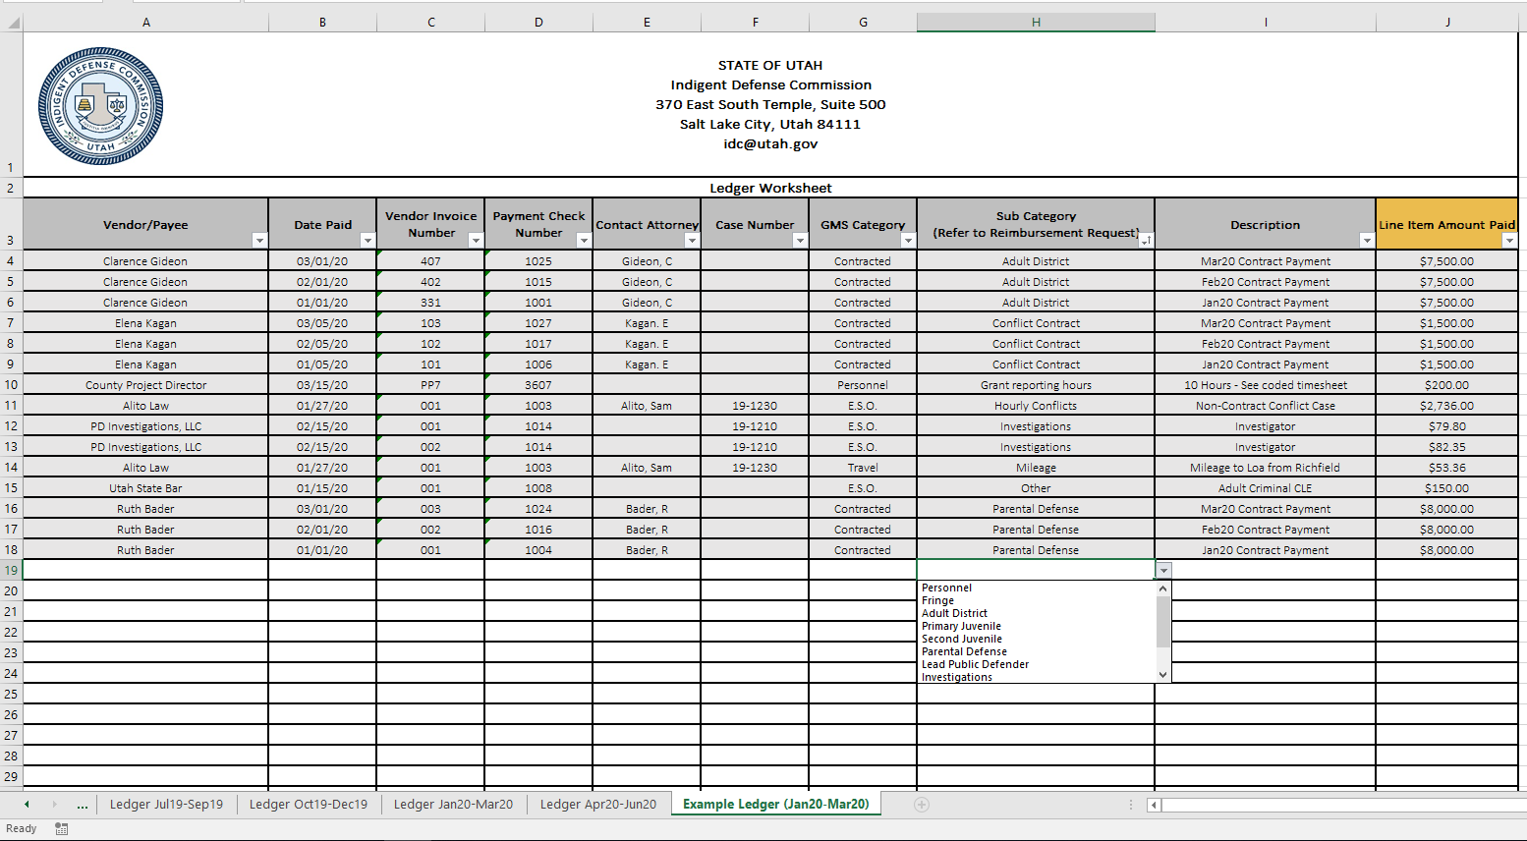
Ledger Tab
Enter all indigent defense expenses for the period individually.
Use the drop down menus to select Sub-Categories. These drop down options are tied to the line items in your grant award budget and align with the Reimbursement Worksheet tab. If an expense does not match one of the options please contact the IDC grant manager for guidance.
Make sure to select the correct reporting period. There is also a tab with examples.

Slide 7
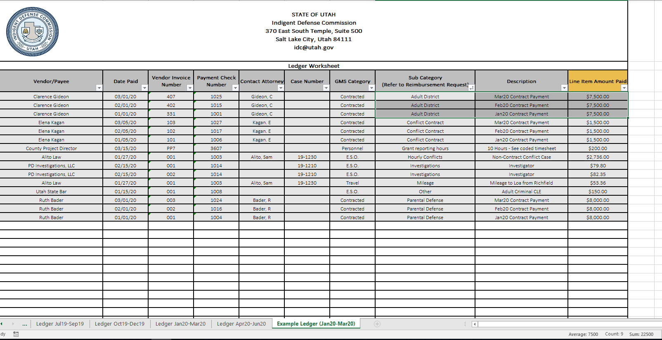
Ledger Tab Continued:
To transfer information to the Reimbursement Worksheet, first sort by sub-category by clicking this icon. Then highlight the amount paid for each item within a sub-category as shown.
Excel provides the sum here. In this example you would enter $22,500 in expenses for the line item titled Adult District.

Slide 8
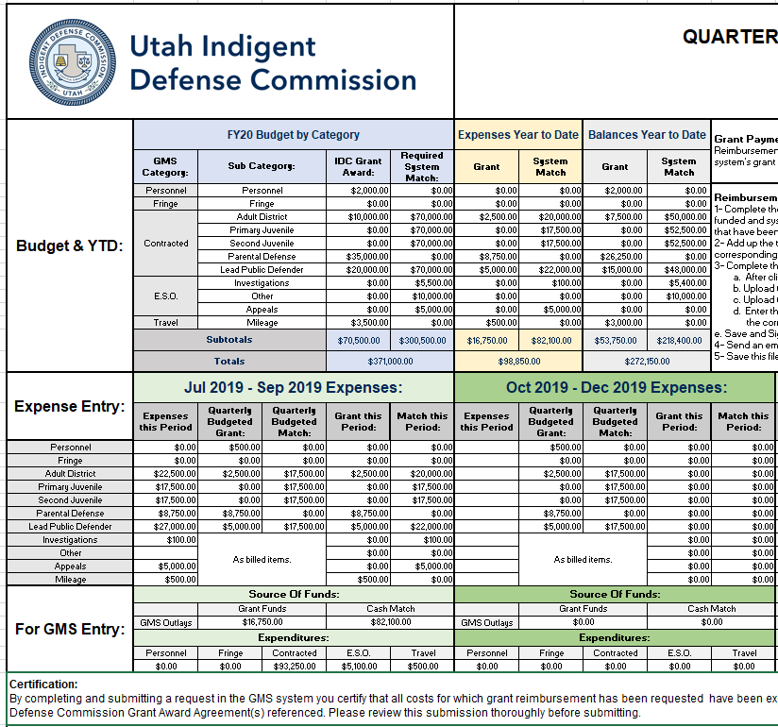
Be sure to save the spreadsheet and work from it each quarter. This will provide you with Year to Date Expenses as well as the remaining balances on your grant and match requirement.
Be sure to enter information under the correct period. This corresponds with the GMS reporting period.
Enter the total expense for each subcategory from your ledger tab.
When all expenses are entered the spreadsheet calculates the amount reimbursable for the period and provides you with the numbers to enter in GMS.
For grantees working with two grant years this section will be color coded and specify the amounts to enter in each grant.

Slide 9
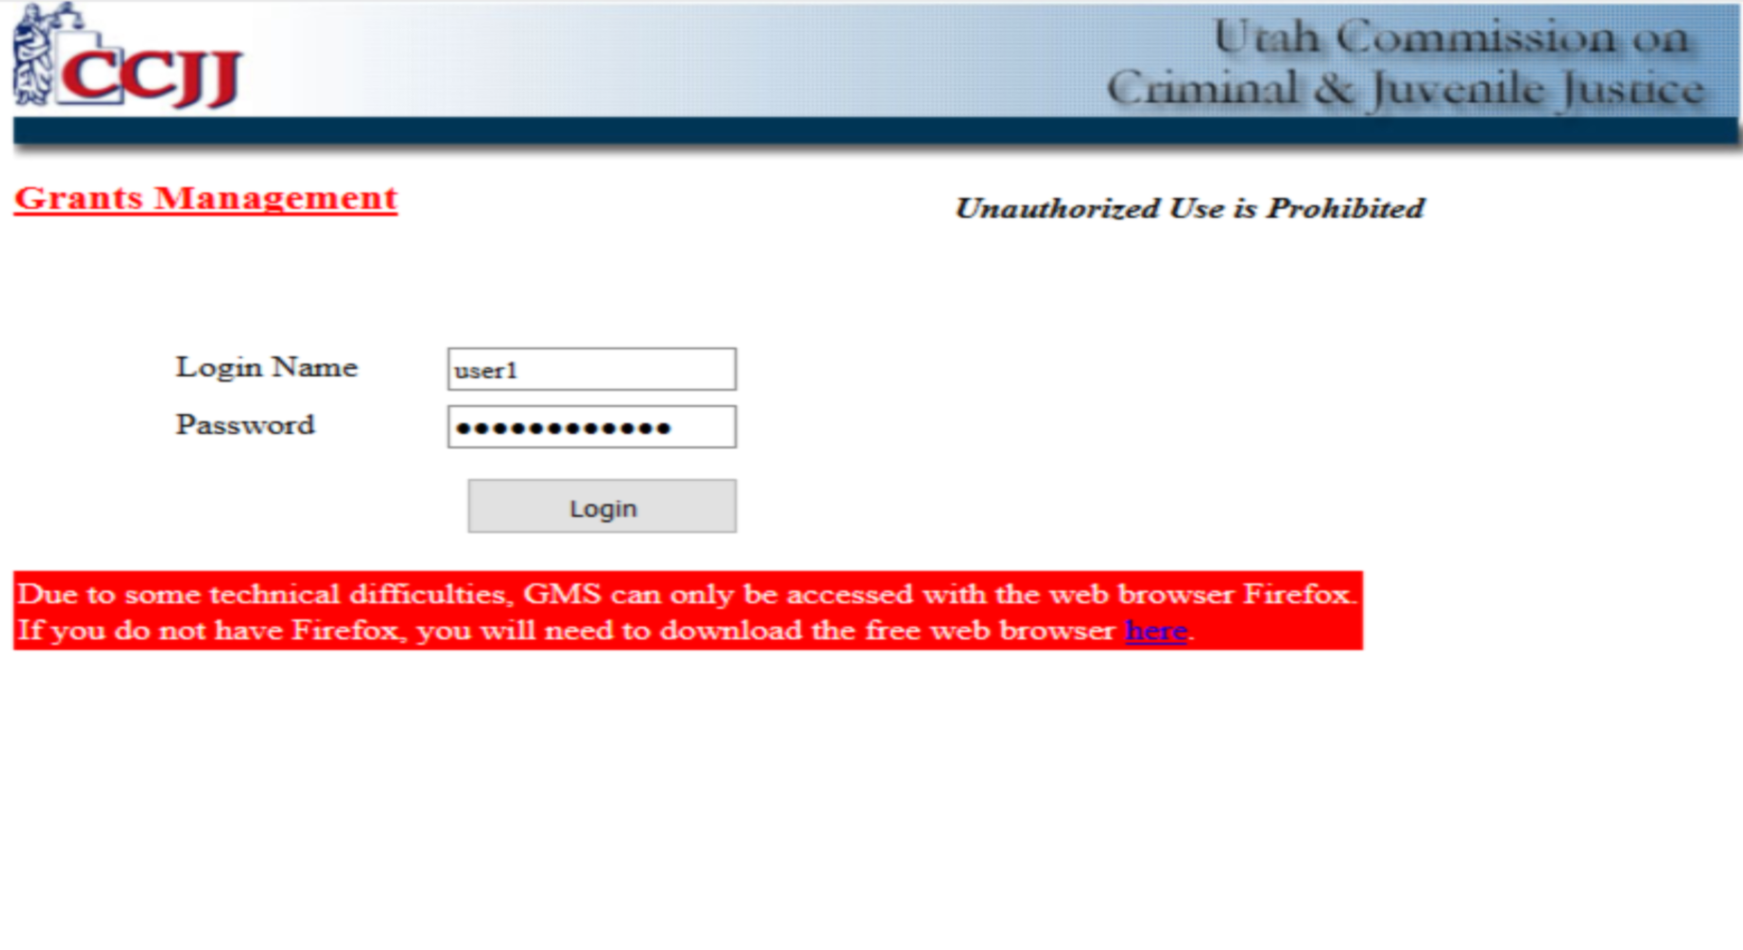
Grants Management System (GMS) Entry
Once you have compiled all the reporting documents listed on the preceding slides, go to the Grants Management System at https://fsr.utah.gov
ALWAYS USE A FIREFOX WEB BROWSER
Once on GMS, enter your username and password. These were sent by email and can be located there if you cannot remember. Please contact the IDC grant manager if you cannot find them.
The following slides will walk you through the process to upload your documents for reimbursement requests.

Slide 10
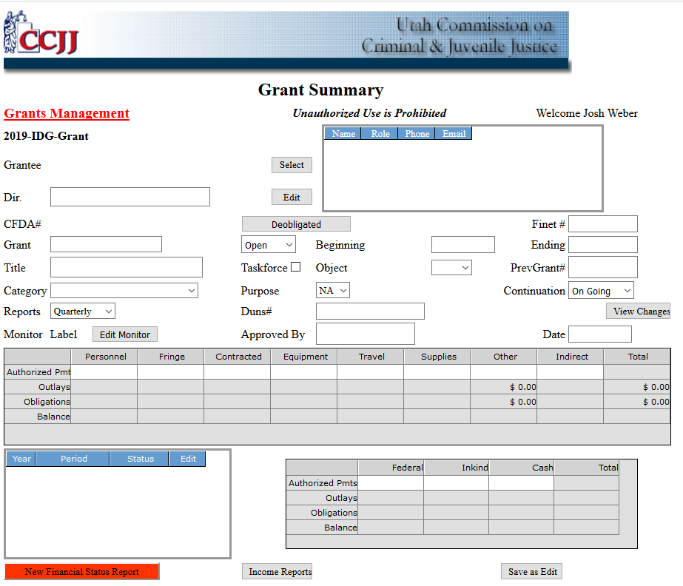
Once logged in, click on New Financial Status Report to begin a new quarterly report.

Slide 11
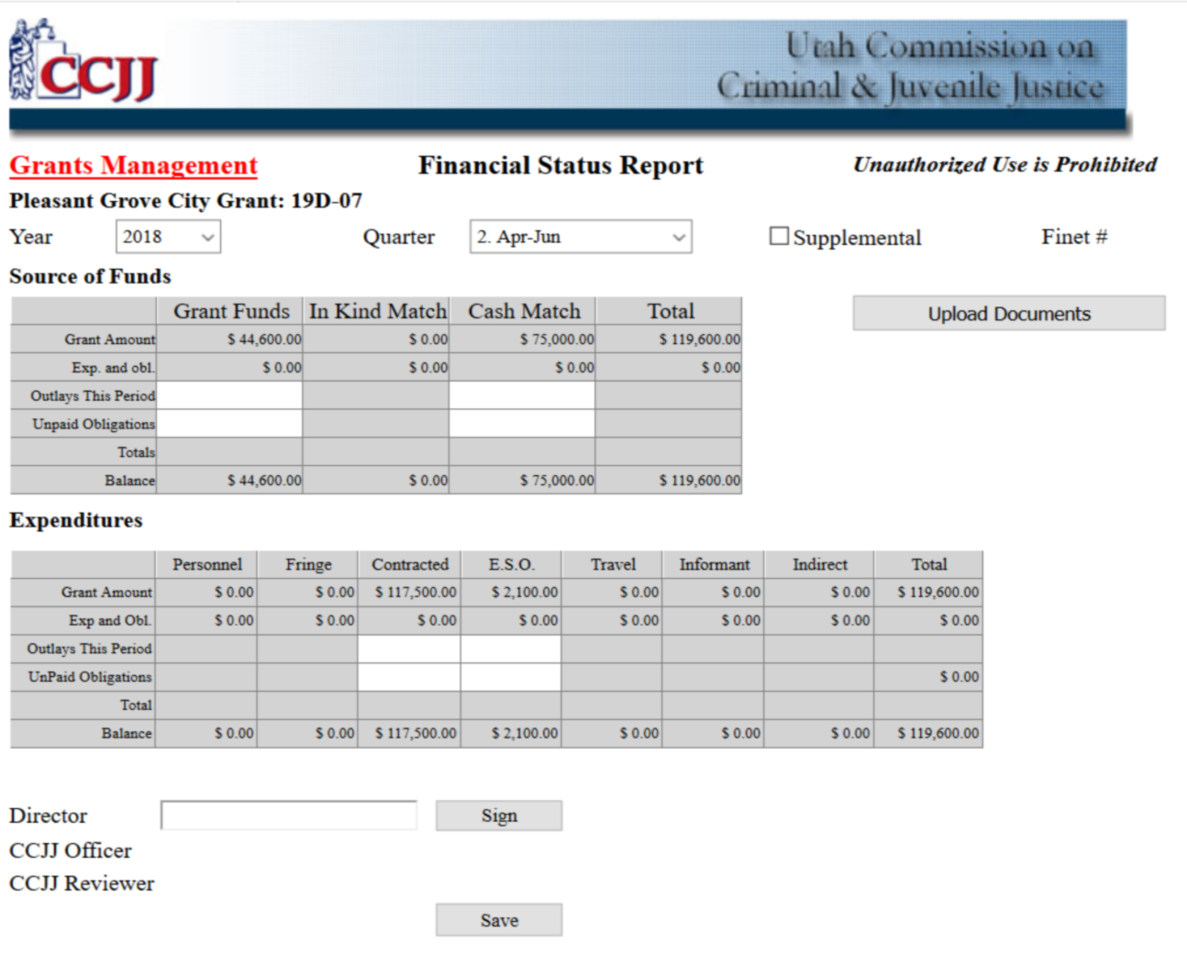
2. Select the correct reporting period and year.
3. Enter the Outlays this Period based on the amounts calculated in the “For GMS Entry” Section of the Reimbursement Worksheet. Leave the Unpaid Obligations fields blank.

Slide 12
4. Click here to upload documents:
Upload the Grantee Progress Report as a Progress Document.
Upload the IDC Reimbursement Worksheet as a Ledger Document.
If using a Budget Detail Report upload that as a Ledger Document as well.
5. When you finish all previous steps:
The grant project director should click “Sign”.
You have the ability to un-sign and edit if needed before the IDC processes the request.
For faster processing, email gregbates@utah.gov when you have submitted.

Slide 13
Frequently Asked Questions
Q: What expenses should be included?
A: All expenses should be included for the period for which they are incurred. Expenses must be paid before they can be reimbursed. If you have an expense to report for a past period due to late payment of the expense, contact the grant program manager for instruction on submitting a supplemental request for the previous period.
Q: What if the project director discovers a mistake in GMS after they have signed?
A: The project director can un-sign and fix the mistake and then re-sign. If the mistake is discovered after the IDC has processed and signed, please contact the IDC grant manager for assistance.
Q: What happens when GMS will not allow me to sign?
A: This is likely due to the total amounts not matching or the documents have not been uploaded. The total Source of Funds must equal the total Expenditures. If the amounts are different, you will see a red warning to fix the entries. Contact the IDC grant manager if you are unable to resolve the issue.
Q: Can I view the prior reports for my grant?
A: Yes, just click on the month/quarter edit button. You also should be able to download previously submitted documents by clicking on the document type link.
Q: Can I change information on a prior report that has been signed by the IDC officer and reviewer?
A: No. Once the IDC officer and reviewer have signed the report, you cannot make any changes. Please contact your grant manager.
Q: Does mileage have to be paid by the city/county prior to requesting reimbursement?
A: Yes. If an attorney has reported a travel expense it should be paid by the municipality before requesting reimbursement. The reimbursement should be reported in the quarter that the expense was paid by the county.
Q: If a pay period spans two quarters which reimbursement request should the pay check be included on?
A: When spanning two quarters payroll should be submitted under the quarter in which it is actually paid. Example: A quarter ends December 31st but the pay period spans December 24th through January 7th. The payroll check date is January 14th. The check would be included on the new quarter (January through March).

Slide 14
Reporting Issues
If you have trouble completing/uploading documentation, we can help!
Call or email:
Greg Bates - Grant Program Manager
Cell: 801-979-3358
Email: gregbates@utah.gov
Backup:
Katriina Adair – Research & Data Analyst
Cell: 801-455-0793
Email: kaadair@utah.gov

